Slide 1
Maker’s university – by intel’s makers community class 3
Gil Tal.
Jan 2020

Slide 3
Class 3 agenda:
Choose your team … ☺
Functional specifications
Arcade’s team – Kick starting
Project specifications
Pickup the right devices
Your thoughts … ☺
Drone’s team – Kick starting
Same process as Arcade’s team
Operating C++

Slide 4
Functional specifications document
Formal document describing a product
Product overview
Technical specifications
Functional Requirements
Components
Costs
Appearance
User interface

Slide 5
Operating c++
Struct in C and typedef
Class in C++
Private\Protected\Public
Inheritance
Constructor
Destructor
Function override
Static Instance VS dynamic allocation (. Vs ->)
Function overloading
Default parameters
Parameters by value\reference\pointer
Arrays
Casting
Extern

Slide 6
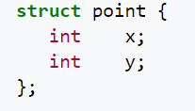
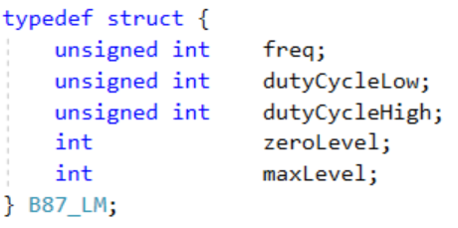
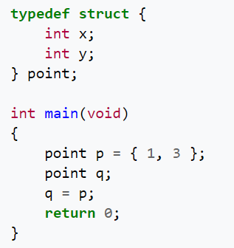
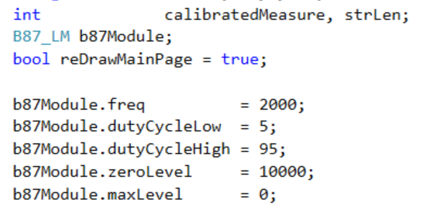
Struct in C and typedef
Composite data type
Grouped list of variables under one name
Accessed via a single pointer or by the struct declared name
Example:

Slide 7
Class in c++
A user-defined type or data structure
Has data and functions (also called member variables and member functions)
Can be accessed as with struct
Variables members and functions can be:
Public
Private
Protected
Constructor: a special member function, executed whenever we create new objects of the class
Have the exact same name as the class
Does not have any return type
Useful for setting initial values for member variables
Destructor: a special member function, executed the class is deleted or released
Have the exact same name as the class prefixed with a tilde (~)
It can neither return a value or take any parameters
Useful for releasing resources like releasing memories and closing files

Slide 8
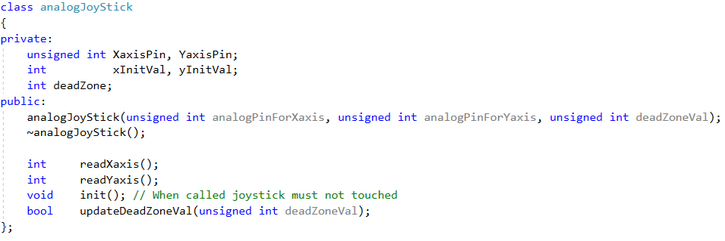

Class in c++

Slide 9
Inheritance
Once we have a class we can inherit from it to form a new class with expanded capabilities
Derived class (child): the class that inherits from another class
Base class (parent): the class being inherited from
To inherit from a class we use the “:” symbol
Multiple Inheritance: a class can also be derived from more than one base class
Access Specifiers:
Public: members of a class are accessible from outside the class
Private: members can only be accessed within the class
Protected: members cab be accessed within the class and in the inherited class.

Slide 10
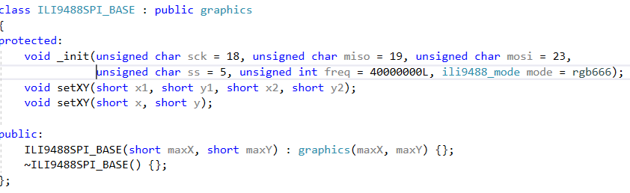
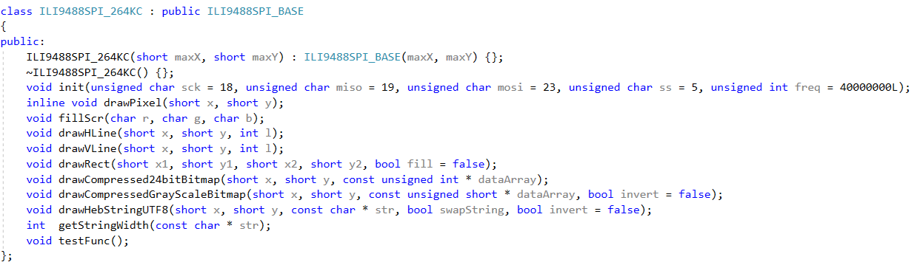
Inheritance

Slide 11
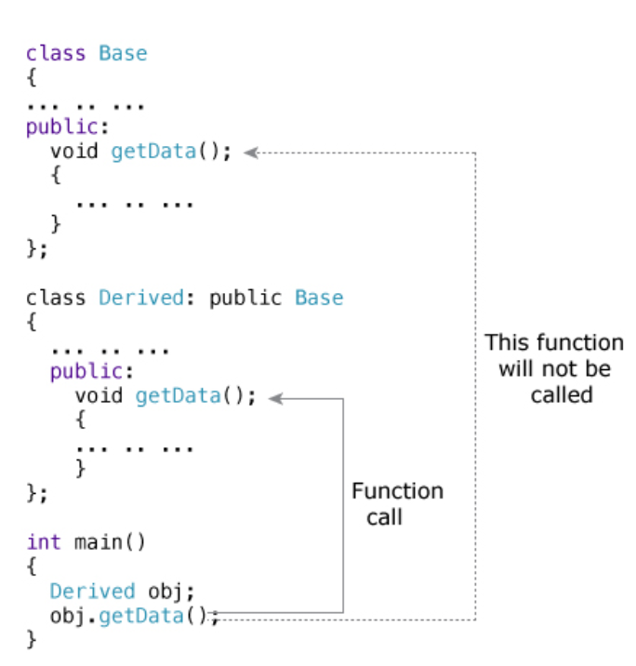
Function Overriding
A child class inherits data and function members of parent class
Overriding is a redefinition of base class function in its derived class
The two functions have the same signature
It can only be done in derived class
Used to override the functionality in the child class
To access the overridden function of the base class:
scope resolution operator :: is used
Example:
If you want to access getData() of the base class:
Use the following in the derived class:

Slide 12
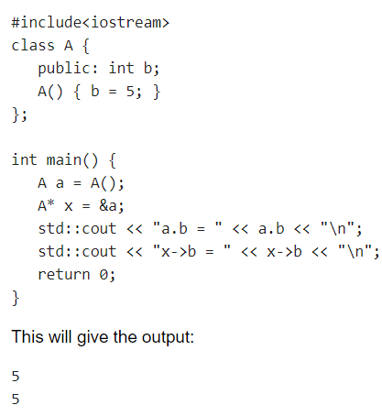
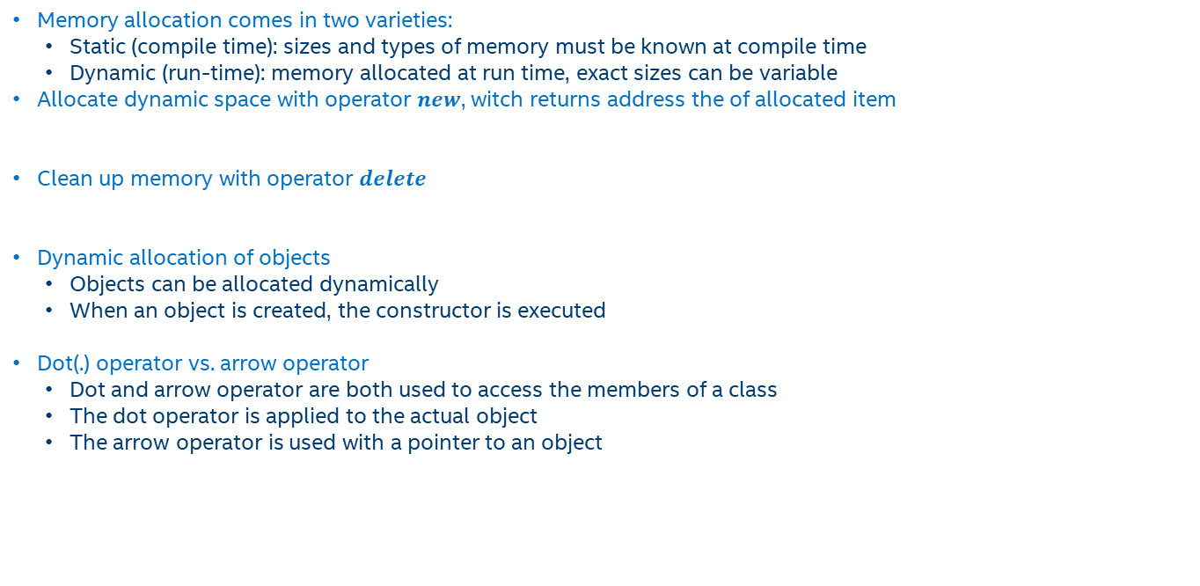
Static Instance VS dynamic allocation (. Vs ->)
Memory allocation comes in two varieties:
Static (compile time): sizes and types of memory must be known at compile time
Dynamic (run-time): memory allocated at run time, exact sizes can be variable
Allocate dynamic space with operator $new$, witch returns address the of allocated item
Clean up memory with operator $delete$
Dynamic allocation of objects
Objects can be allocated dynamically
When an object is created, the constructor is executed
Dot(.) operator vs. arrow operator
Dot and arrow operator are both used to access the members of a class
The dot operator is applied to the actual object
The arrow operator is used with a pointer to an object

Slide 13


Function OVERLOADING
Two or more functions can have the same name but different parameters
There are two ways to overload a function:
Having a different number of argument
Having different arguments types
Instead of defining two functions that should do the same thing, it is better to overload one
Overloaded functions may or may not have different return type, but it should have different arguments
In the example below, even though the functions have different return types, it is not valid
The parameter list should be different

Slide 14

Default parameters
A default argument is a default value provided for a function parameter
If we do not supply an explicit argument, the default value will be used
If we do supply an argument for the parameter, the user-supplied argument is used
All default arguments must be for the rightmost parameters. The following is not allowed:
A function can have multiple default arguments
Functions with default arguments may be overloaded. But:
The default parameter do NOT count towards the parameter that make the function unique
The following is not allowed:

Slide 15
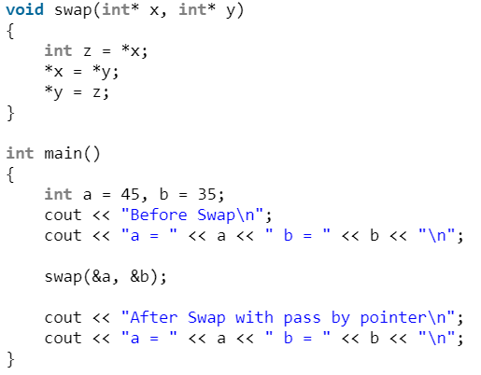


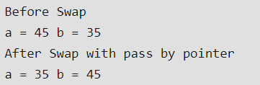
Parameters by value\reference\pointer
A pointer variable holds the memory address of some other variable
A reference variable “refers to” another variable
Pass by value when:
The function does not want to modify the parameter
The value is simple to copy
Pass by pointer when:
The value is expensive to copy
There is a need to modify the value
Pass by reference when:
The value is expensive to copy
The function want to modify the value referred to
NULL would not be a valid value if a pointer was used instead

Slide 16
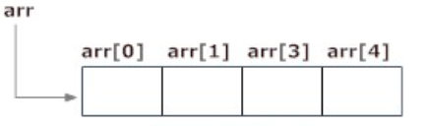



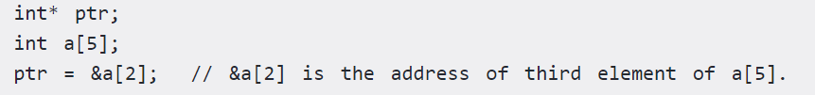
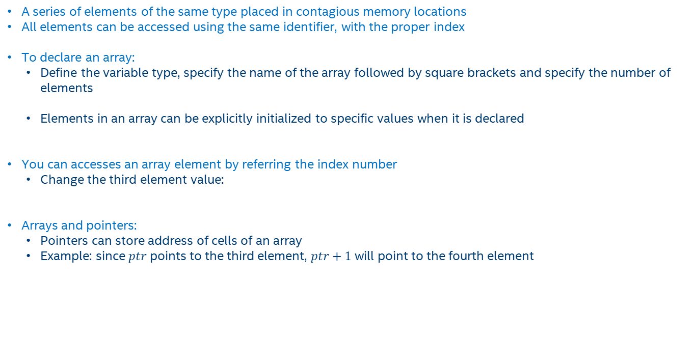
C++ Arrays
A series of elements of the same type placed in contagious memory locations
All elements can be accessed using the same identifier, with the proper index
To declare an array:
Define the variable type, specify the name of the array followed by square brackets and specify the number of elements
Elements in an array can be explicitly initialized to specific values when it is declared
You can accesses an array element by referring the index number
Change the third element value:
Arrays and pointers:
Pointers can store address of cells of an array
Example: since $ptr$ points to the third element, $ptr+1$ will point to the fourth element

Slide 17

CASTING
A cast is a special operator that forces one data type to be converted into another
Other casting operators supported by C++
dynamic_cast: a run-time cast, performs casts on polymorphic types
static_cast: performs a nonpolymorphic cast, it can be used to cast a base class pointer into a derived class pointer
reinterpret_cast: changes a pointer to any other type of pointer
static_cast: used explicitly to override const and/or volatile in a cast

Slide 18

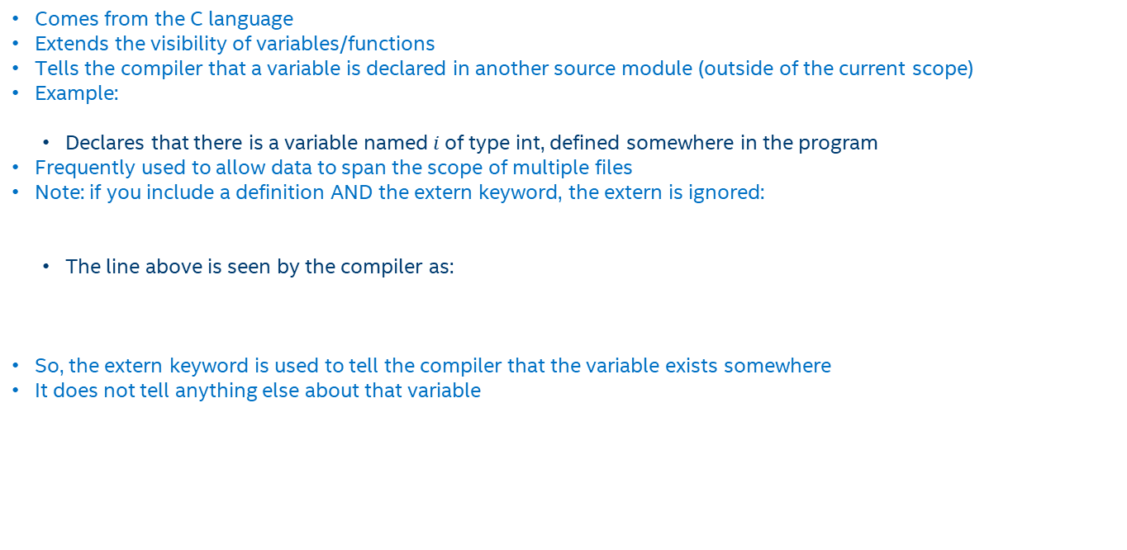
EXTERN
Comes from the C language
Extends the visibility of variables/functions
Tells the compiler that a variable is declared in another source module (outside of the current scope)
Example:
Declares that there is a variable named$i$of type int, defined somewhere in the program
Frequently used to allow data to span the scope of multiple files
Note: if you include a definition AND the extern keyword, the extern is ignored:
The line above is seen by the compiler as:
So, the extern keyword is used to tell the compiler that the variable exists somewhere
It does not tell anything else about that variable

